Slide 1
Title: Migrating to .NET Core Microservices and Deploying in Azure
Subtitle: A Transformative Journey to Scalability and Efficiency
ABC (Company logo)
Presenter Name : Mohit
Date : 03-06-2022

Slide 2
Agenda
Introduction
Business Challenges
Benefits of .NET Core Microservices
Azure Cloud Advantages
Migration Strategy
Deployment in Azure
Case Studies and Success Stories
Q&A

Slide 3
Introduction
Brief introduction about your company.
Overview of your expertise in .NET Core and Azure.
Objective of the presentation.

Slide 4
Business Challenges in eCommerce
Scalability: Difficulty in Handling Traffic Spikes During Sales Events
Issue: Current system struggles to scale effectively during high-traffic periods such as Black Friday, leading to potential downtime and lost sales.
Impact: Reduced customer satisfaction and revenue loss.
Performance: Slow Response Times Affecting User Experience
Issue: The existing monolithic application has performance bottlenecks, causing slow load times and delayed transactions.
Impact: Poor user experience and decreased customer retention.
Flexibility: Challenges in Quickly Deploying New Features
Issue: Introducing new features or updates requires significant time and effort due to the tightly coupled nature of the monolithic architecture.
Impact: Slower time-to-market and inability to respond swiftly to market demands.
Maintenance: High Maintenance Cost for Monolithic Architecture
Issue: Maintaining and updating the monolithic codebase is complex and costly, involving significant developer resources and time.
Impact: Increased operational costs and resource allocation challenges.
Security: Ensuring Secure Transactions and Data Protection
Issue: The outdated framework presents vulnerabilities, making it challenging to ensure secure transactions and protect sensitive customer data.
Impact: Increased risk of data breaches and loss of customer trust.

Slide 5
Slide 4: Business Challenges in eCommerce
Scalability: Difficulty in handling traffic spikes during sales events.
Performance: Slow response times affecting user experience.
Flexibility: Challenges in quickly deploying new features.
Maintenance: High maintenance cost for monolithic architecture.
Security: Ensuring secure transactions and data protection.

Slide 6
Overview of your expertise in .NET Core and Azure.

Slide 7
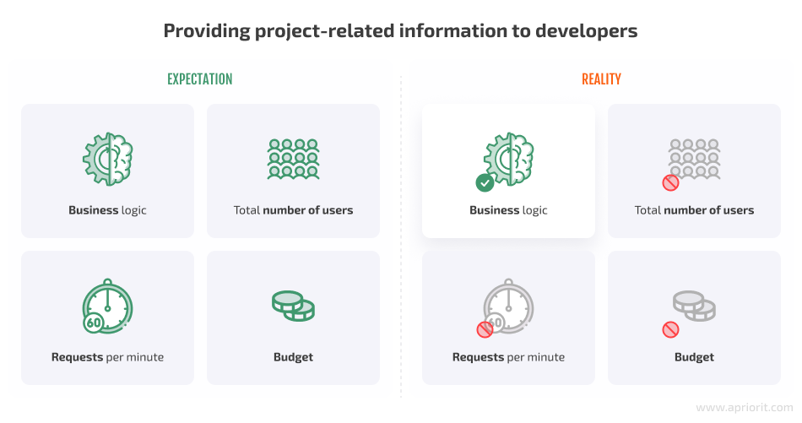

Slide 8
https://weblog.plexobject.com/
Effective Load Shedding and Throttling Strategies for Managing Traffic Spikes and DDoS Attacks

Slide 9
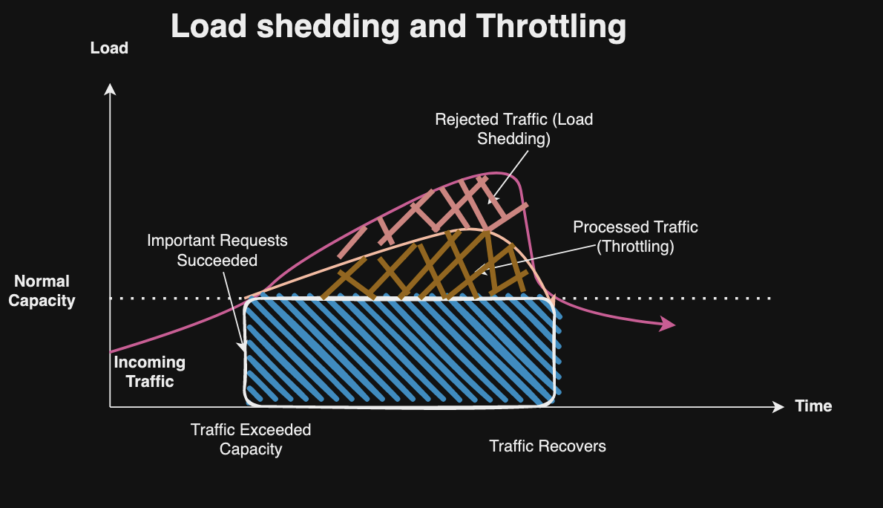

Slide 10
5: Advantages of .NET Core Microservices for eCommerce
Scalability: Easily scale individual services based on demand.
Flexibility: Faster deployment of new features and updates.
Performance: Improved load times and responsiveness.
Resilience: Better fault isolation, reducing the impact of failures.
Technology Agnostic: Integration with diverse technologies and platforms.

Slide 11
6: .NET Core Microservices Architecture
Diagram: Visual representation of a typical eCommerce microservices architecture.
Components:
API Gateway for unified access.
Independent microservices for inventory, payment, user management, etc.
Message broker for asynchronous communication.
Databases per microservice for data isolation

Slide 12
7: Migration and Deployment Strategy
Assessment: Analyze current system and identify microservices candidates.
Planning: Define a detailed roadmap with milestones.
Design: Architect microservices with a focus on eCommerce needs.
Development: Build microservices using .NET Core.
Testing: Conduct thorough testing to ensure robustness.
Deployment: Deploy microservices on Azure.
Monitoring: Implement continuous monitoring and optimization.

Slide 13
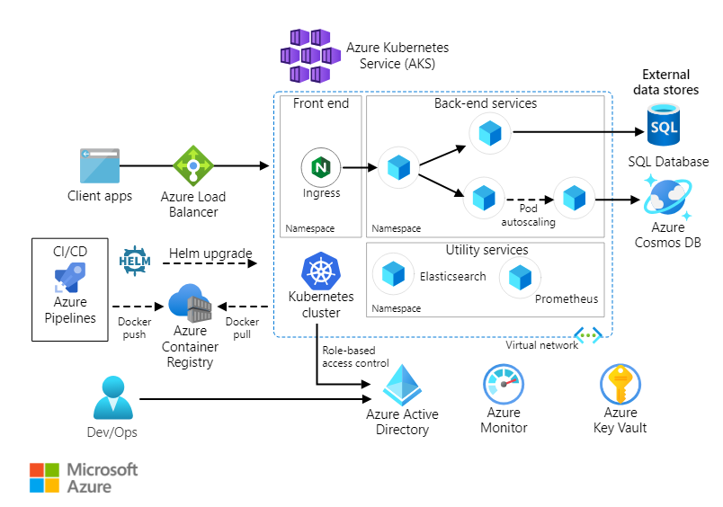

Slide 14
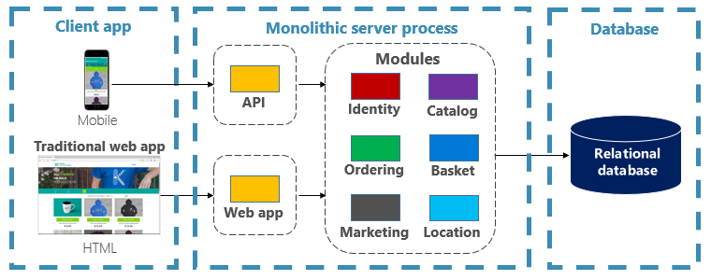
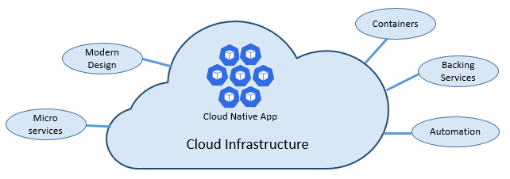
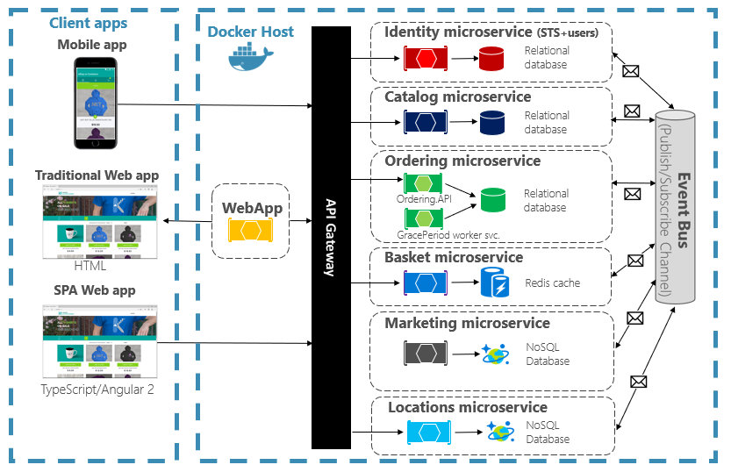
Notes:
https://learn.microsoft.com/en-us/dotnet/architecture/cloud-native/introduction

Slide 15
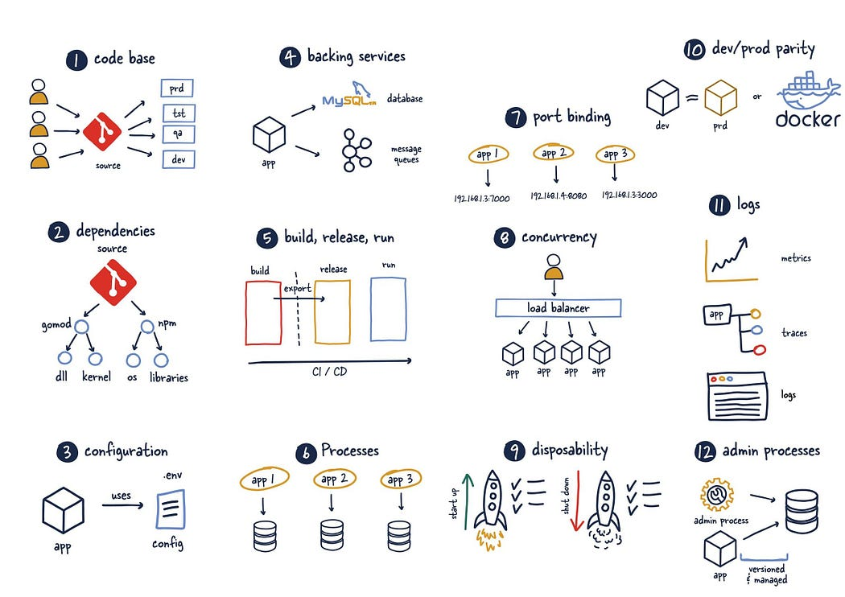
Modern design How would you design a cloud-native app? What would your architecture look like? To what principles, patterns, and best practices would you adhere? What infrastructure and operational concerns would be important?
Notes:
https://gnithyanantham.medium.com/mastering-scalable-and-maintainable-applications-a-comprehensive-guide-to-12-factor-app-1a46caf803c2

Slide 16
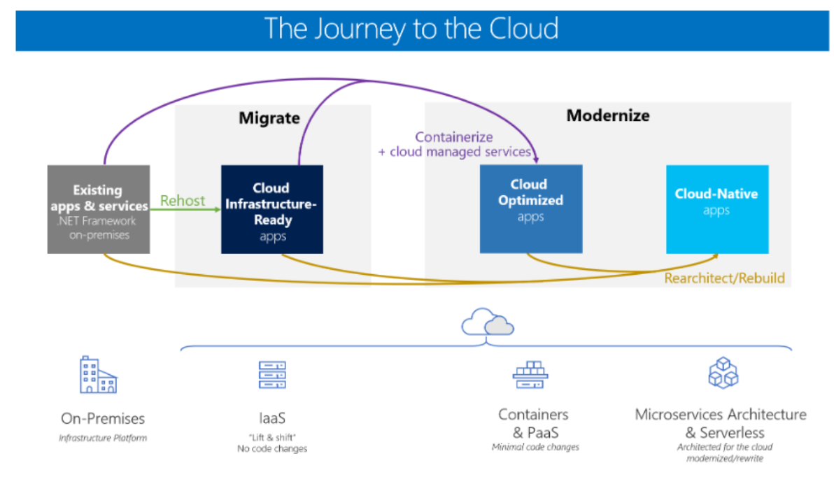
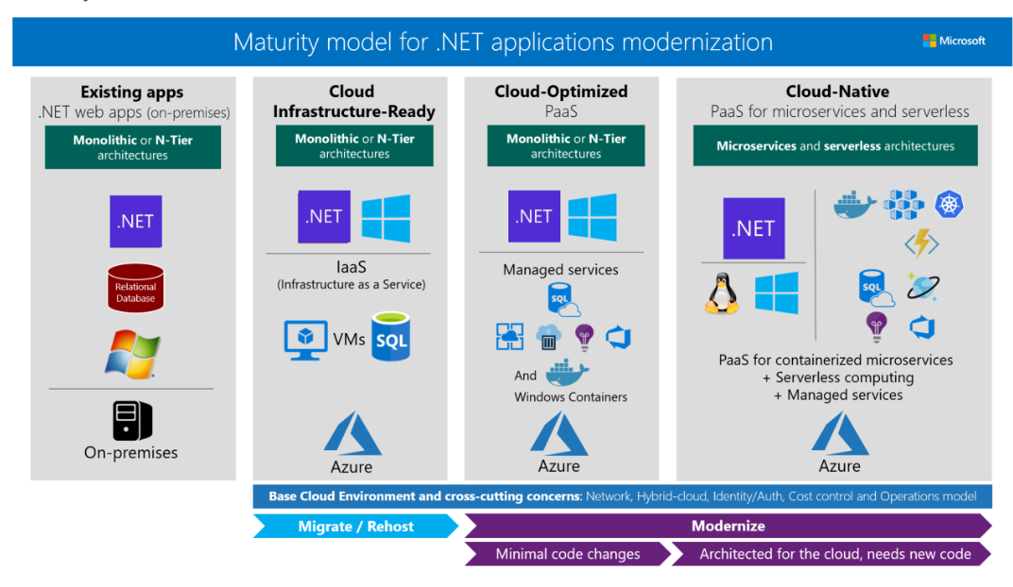

Slide 17
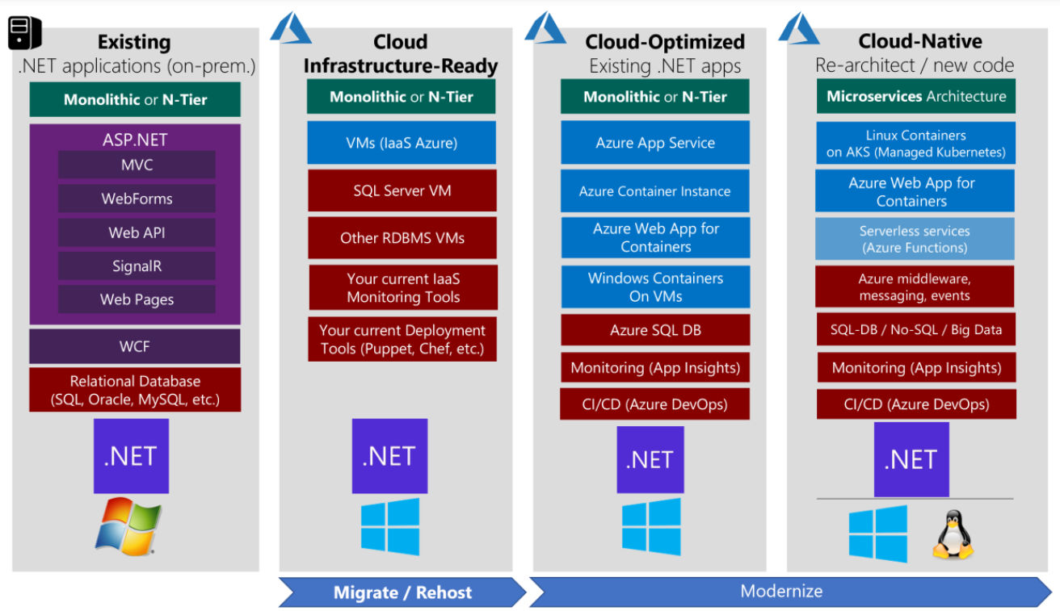

Slide 18
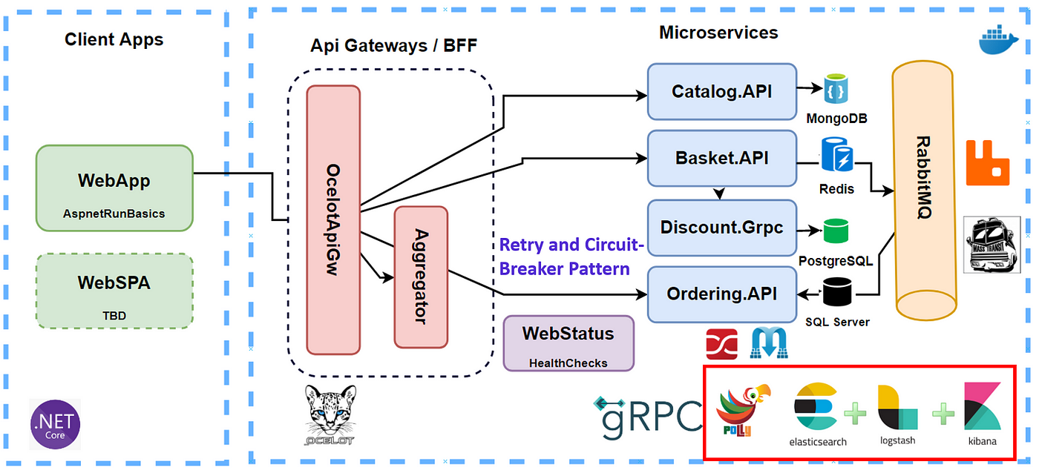

Slide 19
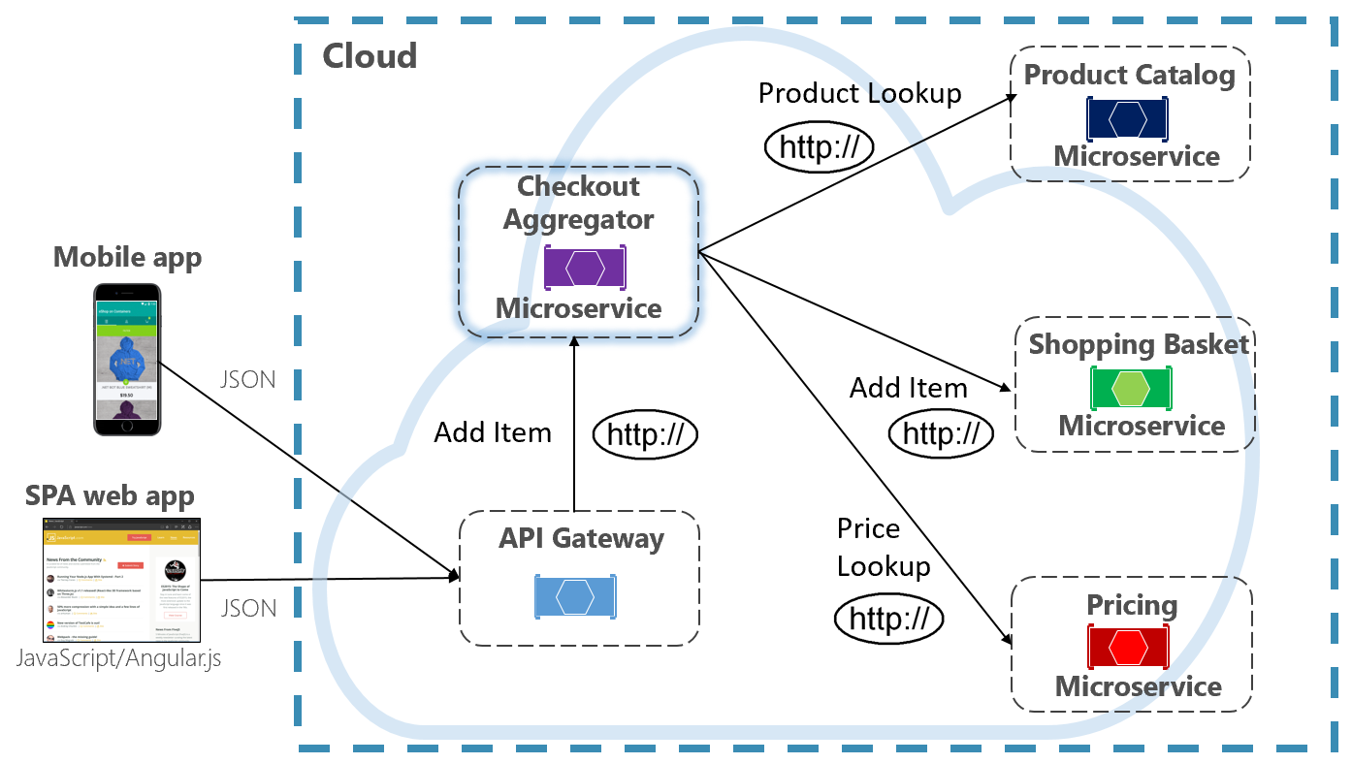

Slide 20
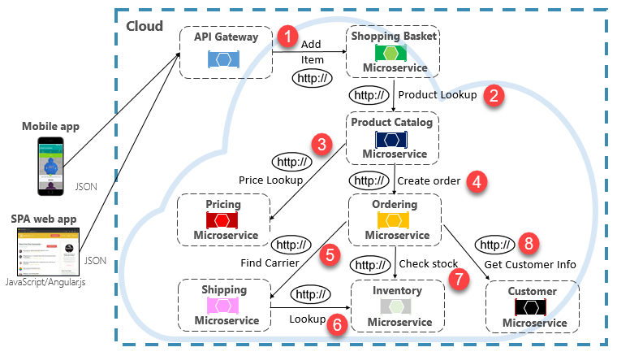

Slide 22
Migrating an eCommerce system to a microservices architecture using .NET Core and deploying it on Azure
1. Assessment:
Analyze Current System: Evaluate the existing eCommerce system to identify its architecture, components, dependencies, and pain points.
Identify Microservices Candidates: Determine which functionalities or modules can be decoupled and migrated to microservices to improve scalability, flexibility, and maintainability.
2. Planning:
Define Roadmap: Develop a detailed migration roadmap with specific milestones, timelines, and resource allocations.
Allocate Resources: Assign roles and responsibilities to team members, including developers, architects, testers, and operations personnel.
Risk Assessment: Identify potential risks and mitigation strategies for the migration process.
3. Design:
Architect Microservices: Design the microservices architecture with a focus on eCommerce needs, such as catalog management, order processing, payment integration, user authentication, and recommendation engines.
Define Interfaces: Clearly define the interfaces and communication protocols between microservices to ensure loose coupling and interoperability.
Consider Domain-Driven Design (DDD): Utilize DDD principles to model microservices around specific business domains, enabling better alignment with business requirements.
4. Development:
Build Microservices: Develop microservices using .NET Core, leveraging frameworks like ASP.NET Core for building RESTful APIs.
Containerization: Containerize microservices using Docker to ensure consistency and portability across different environments.
Implement CI/CD Pipelines: Set up continuous integration and deployment pipelines using tools like Azure DevOps to automate the build, test, and deployment processes.
5. Testing:
Unit Testing: Conduct unit tests for individual microservices to verify their functionality in isolation.
Integration Testing: Perform integration tests to ensure that microservices communicate correctly and function together as expected.
End-to-End Testing: Execute end-to-end tests to validate the entire eCommerce system's functionality, including user interactions and data flows.
6. Deployment:
Deploy on Azure: Use Azure Kubernetes Service (AKS) to deploy and manage containerized microservices in a scalable and resilient Kubernetes environment.
Implement Blue-Green Deployment: Implement blue-green deployment strategies to minimize downtime and ensure seamless updates.
Monitor Deployment: Monitor deployment metrics and logs to identify any issues and quickly roll back changes if necessary.
7. Monitoring:
Continuous Monitoring: Implement continuous monitoring solutions using Azure Monitor and Application Insights to track the performance, availability, and health of microservices.
Alerting: Set up alerts and notifications to proactively identify and respond to any anomalies or performance degradation.
Optimization: Continuously optimize microservices based on monitoring data, user feedback, and changing business requirements to ensure efficiency and cost-effectiveness.

Slide 23
Best Practice / Tool for Performance

Slide 24
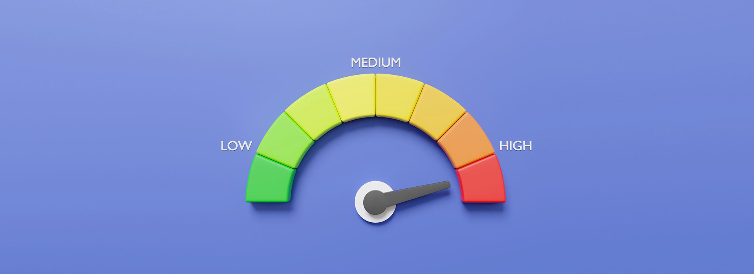
Azure Cloud Advantages
Scalability: Use Azure Kubernetes Service (AKS) for auto-scaling microservices.
Performance: Low latency and high availability through global distribution.
Security: Advanced security features and compliance certifications.
Cost Efficiency: Pay-as-you-go pricing model, reducing operational costs.
Integration: Seamless integration with other Azure services (Azure DevOps, Azure SQL, etc.).
Azure Services for eCommerce
Azure Kubernetes Service (AKS): Container orchestration and auto-scaling.
Azure DevOps: CI/CD pipelines for automated deployments.
Azure Cosmos DB: Globally distributed, multi-model database.
Azure App Configuration: Centralized management of configurations.
Azure Monitor & Application Insights: Real-time monitoring and logging.

Slide 25
Microsoft Azure offers a range of advantages for hosting and managing .NET Core microservices.
Seamless Integration with Microsoft Ecosystem:
Azure is deeply integrated with Microsoft's ecosystem, making it a natural choice for .NET Core applications. This allows for better tooling, easier development workflows, and streamlined management.
Azure Kubernetes Service (AKS):
Azure Kubernetes Service simplifies the deployment, management, and operations of Kubernetes. AKS offers automated provisioning, scaling, and monitoring, making it ideal for microservices architecture.
Azure DevOps:
Azure DevOps provides end-to-end DevOps toolchains for developing and deploying applications. It integrates well with .NET Core, offering CI/CD pipelines, version control, and package management.
Scalability and Flexibility:
Azure offers robust scalability options with services like Azure App Services, Azure Functions, and AKS, allowing applications to scale seamlessly based on demand.
Managed Databases:
Azure provides a variety of managed database services such as Azure SQL Database, Azure Cosmos DB, and Azure Database for PostgreSQL, which offer high availability, security, and performance.
Monitoring and Diagnostics:
Azure provides comprehensive monitoring and diagnostics with Azure Monitor and Application Insights, offering real-time insights into application performance and health.
Security and Compliance:
Azure offers a wide range of security features, including Azure Active Directory, Key Vault, and managed identities, ensuring secure and compliant application deployments.
Global Reach:
With data centers in many regions across the globe, Azure provides low-latency access and compliance with regional data regulations, enhancing the performance and availability of applications.
Azure Services for
.NET Core Microservices
Azure Kubernetes Service (AKS)
Azure DevOps
Azure App Service
Azure Functions
Azure SQL Database
Azure Cosmos DB
Azure Monitor
Azure Application Insights
Azure Active Directory
Azure Key Vault
Azure Container Registry
Azure Logic Apps
Azure Event Grid
Azure Service Bus
Azure API Management

Slide 26
Azure Services | Configuration Details | Est. Monthly Cost (USD)
Azure Kubernetes Service (AKS) | 3-node cluster, D2_v3 VMs (2 vCPU, 8GB RAM) | $500
Azure DevOps | Basic Plan with 5 users, 2 parallel jobs for CI/CD | $30
Azure App Service | Premium Plan P1v3, 1 instance (4 vCPU, 8GB RAM) | $230
Azure Functions | Consumption Plan, 1 million executions, 400,000 GB-s | $20
Azure SQL Database | Standard S2 instance (50 DTUs, 250GB storage) | $75
Azure Cosmos DB | Single region write, 10,000 RU/s, 500GB storage | $600
Azure Monitor | 200 GB of logs, 50 alert rules | $200
Azure Application Insights | 100 GB of data ingestion, 1 million events | $100
Azure Active Directory | Premium P1, 100 users | $60
Azure Key Vault | Standard tier, 1000 operations per month | $3
Azure Container Registry | Standard tier, 100GB storage, 1 million operations | $20
Azure Logic Apps | Standard Plan, 1 million actions | $120
Azure Event Grid | 1 million operations | $10
Azure Service Bus | Standard tier, 1 million operations | $10
Azure API Management | Developer tier, 1 million API calls | $150
Cost Category` | Details | Est. Monthly Cost (USD)
Hardware | Servers, storage devices, networking equipment | $10,000 - $20,000
Software Licenses | Operating systems, databases, other software | $1,000 - $5,000
Data Center Costs | Rent, power, cooling, maintenance | $5,000 - $10,000
IT Staff | Salaries for IT personnel | $8,000 - $15,000
Backup and Disaster Recovery | Backup solutions, offsite storage, DR planning | $2,000 - $5,000
Security | Firewalls, antivirus software, intrusion detection | $3,000 - $7,000
Monitoring Tools | Network monitoring, server monitoring tools | $1,000 - $3,000
Total Estimated Monthly Cost: $30,000 - $55,000
Total Estimated Monthly Cost: ~$2128

Slide 27
Notes:
AKS: Cost includes VM instances, networking, and storage. Actual costs can vary based on the number of nodes and VM size.
Azure DevOps: Costs can increase with more users or additional parallel jobs.
Azure App Service: Higher tiers and scaling out to more instances will increase costs.
Azure Functions: Based on execution count and resource consumption; costs can vary.
Azure SQL Database and Cosmos DB: Costs depend on DTUs/RUs, storage, and data transfer.
Azure Monitor and Application Insights: Costs depend on the amount of data ingested and retention period.
Azure Active Directory: Premium P1 pricing, could vary with different tiers and more users.
Azure Key Vault: Costs for operations and key storage.
Azure Container Registry: Based on storage and usage.
Azure Logic Apps, Event Grid, Service Bus, API Management: Costs based on usage and tier selected.

Slide 28
On-Premise Infrastructure Costs
Hardware: Purchasing servers, storage devices, networking equipment, and other hardware components.
Software Licenses: Licensing fees for operating systems, databases, and other software required to run the services.
Data Center Costs: Expenses related to renting or owning physical space, power, cooling, and maintenance.
IT Staff: Salaries for IT personnel responsible for managing, monitoring, and maintaining the infrastructure.
Backup and Disaster Recovery: Costs associated with implementing and maintaining backup and disaster recovery solutions.
Security: Expenses for implementing security measures such as firewalls, antivirus software, and intrusion detection systems.
Monitoring Tools: Costs for purchasing and maintaining monitoring and management tools.
ROI Analysis
To calculate the ROI (Return on Investment) for migrating to Azure from an on-premise environment, consider the following:
Cost Savings: Calculate the difference in monthly costs between Azure and on-premise infrastructure.
Operational Efficiency: Assess the impact of moving to Azure on operational efficiency, such as faster deployment times, scalability, and automation.
Downtime Reduction: Evaluate the potential reduction in downtime and associated costs by leveraging Azure's high availability and disaster recovery capabilities.
Scalability: Consider the ability to scale resources up or down based on demand, potentially reducing underutilization or over-provisioning of on-premise hardware.
Security and Compliance: Assess the improvements in security and compliance achieved by leveraging Azure's built-in security features and compliance certifications.
Flexibility and Innovation: Consider the ability to adopt new technologies and innovate faster by leveraging Azure's wide range of services and integrations.
Total Cost of Ownership (TCO): Compare the total cost of ownership over time, including initial investment, ongoing operational costs, and potential cost savings and benefits.

Slide 29
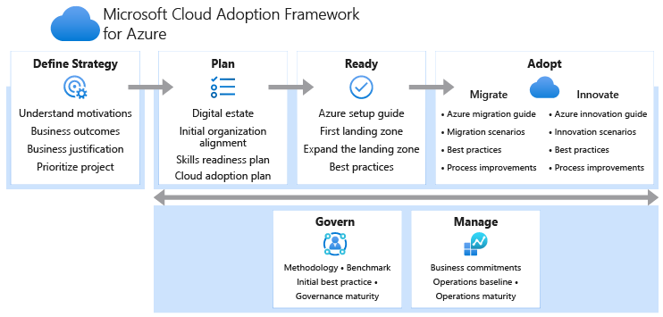

Slide 30
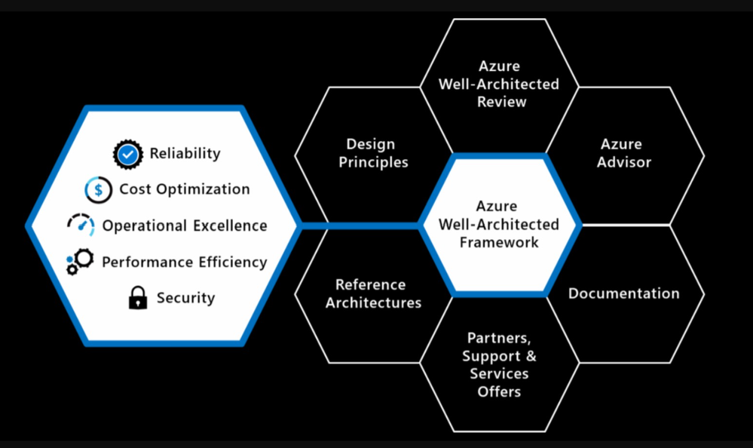

Slide 31
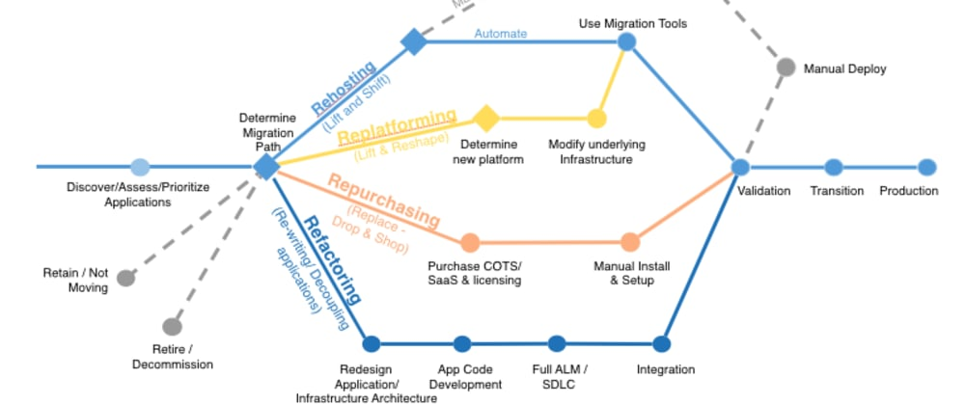

Slide 32
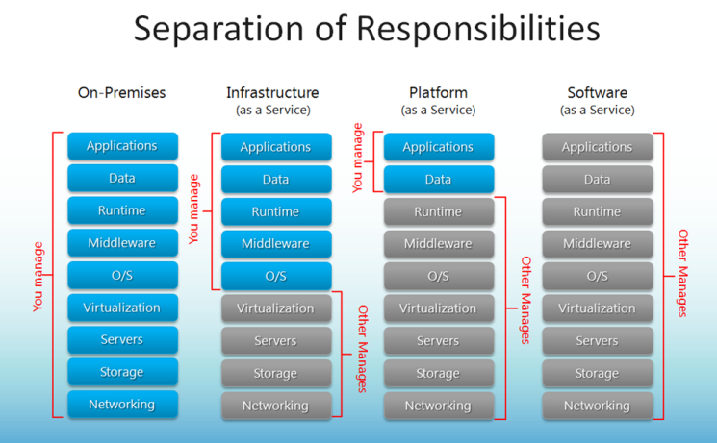

Slide 33
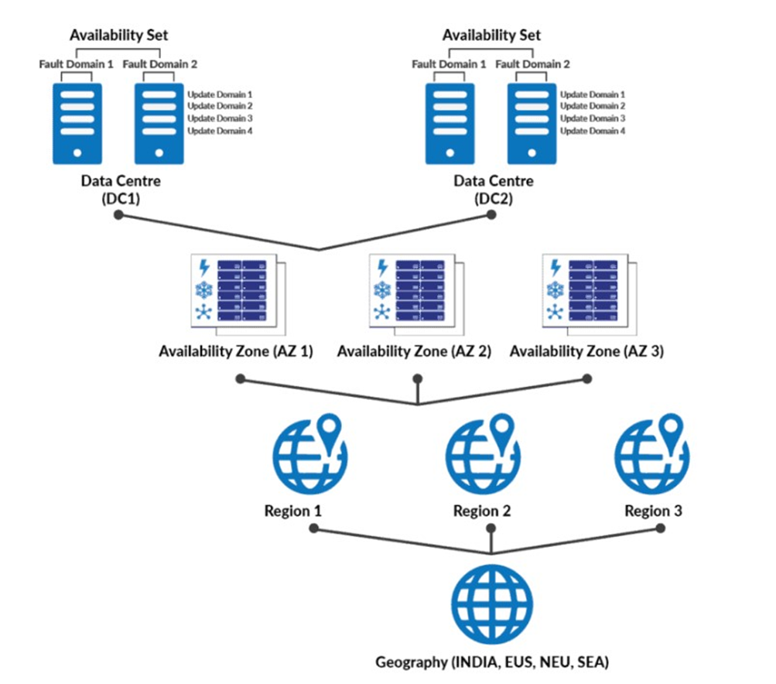
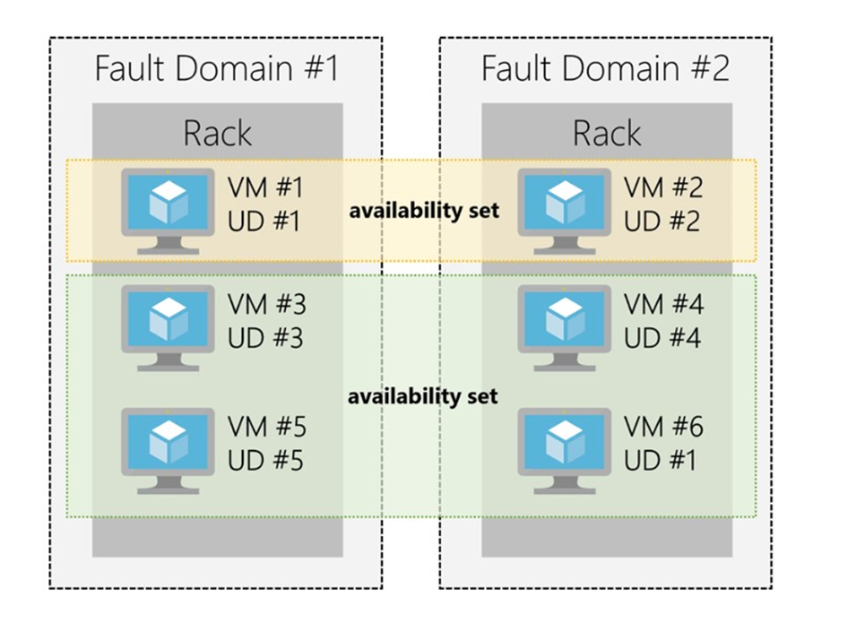
Availability Zone and Availability Set

Slide 34
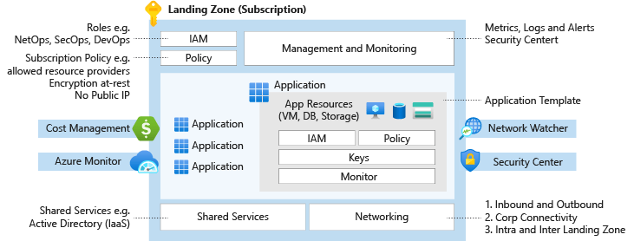
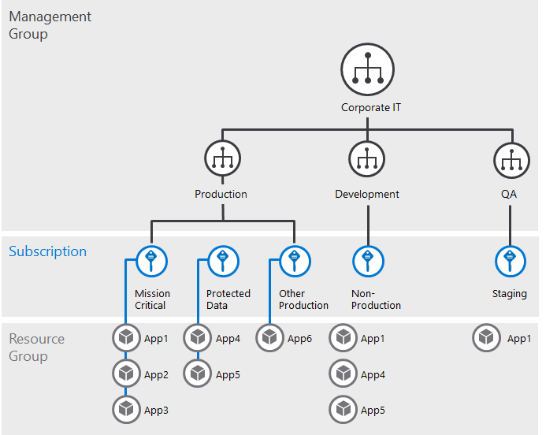
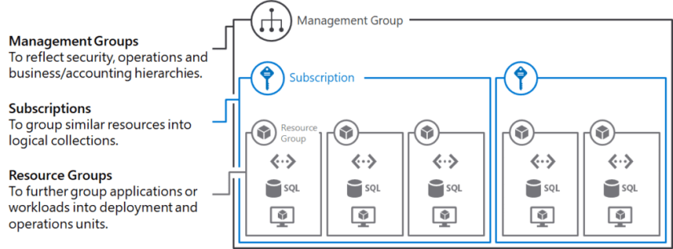
1. IAM, Policy, Management & Monitoring (Role: NetOps, SecOps, DevOps, Subscription, Policies)
Azure MonitorAzure app( VM, DB, Storage, IAM, Policies, Monitor)
2. Azure Cost Management
3. Azure Monitor
4. Network Watcher
5. Security Center
6. Shared Services

Slide 35
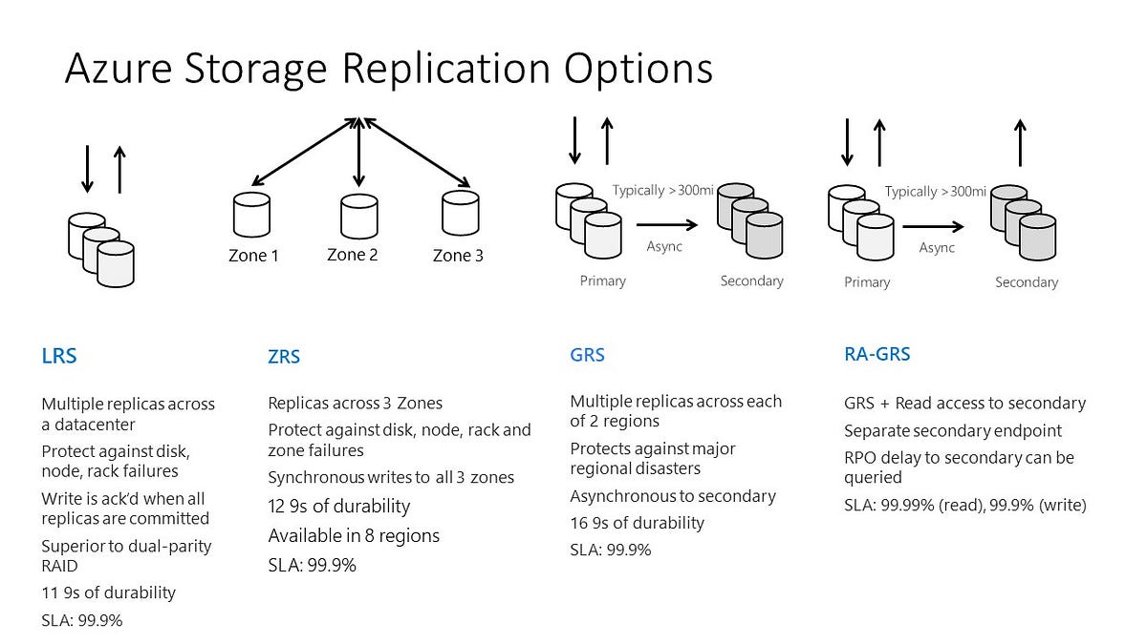

Slide 36
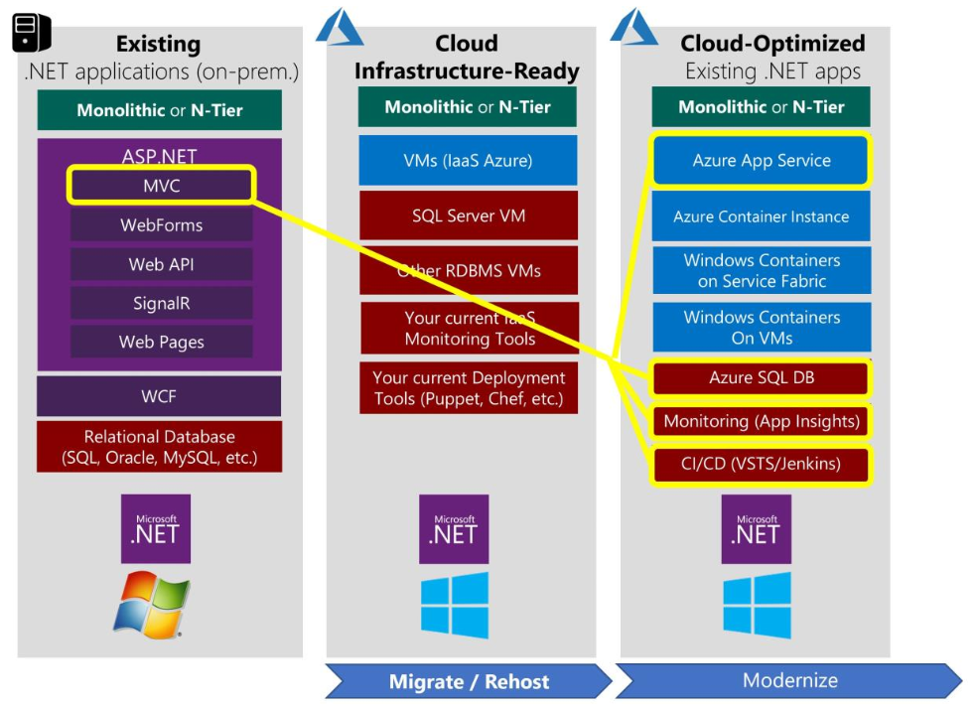

Slide 37
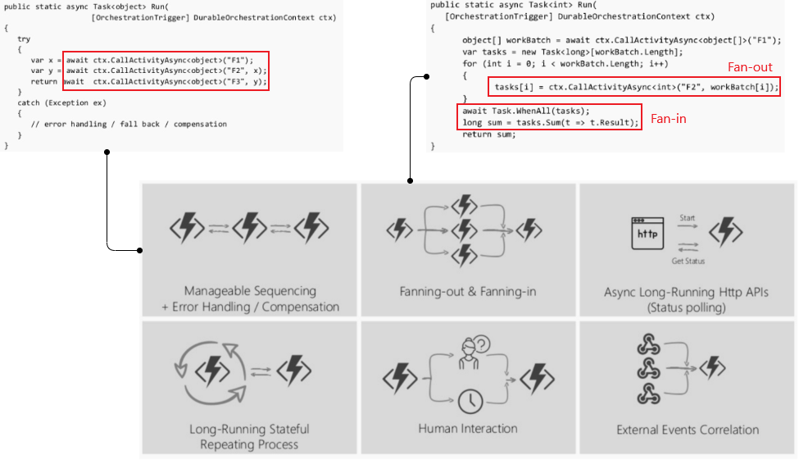
Azure Durable Function

Slide 38
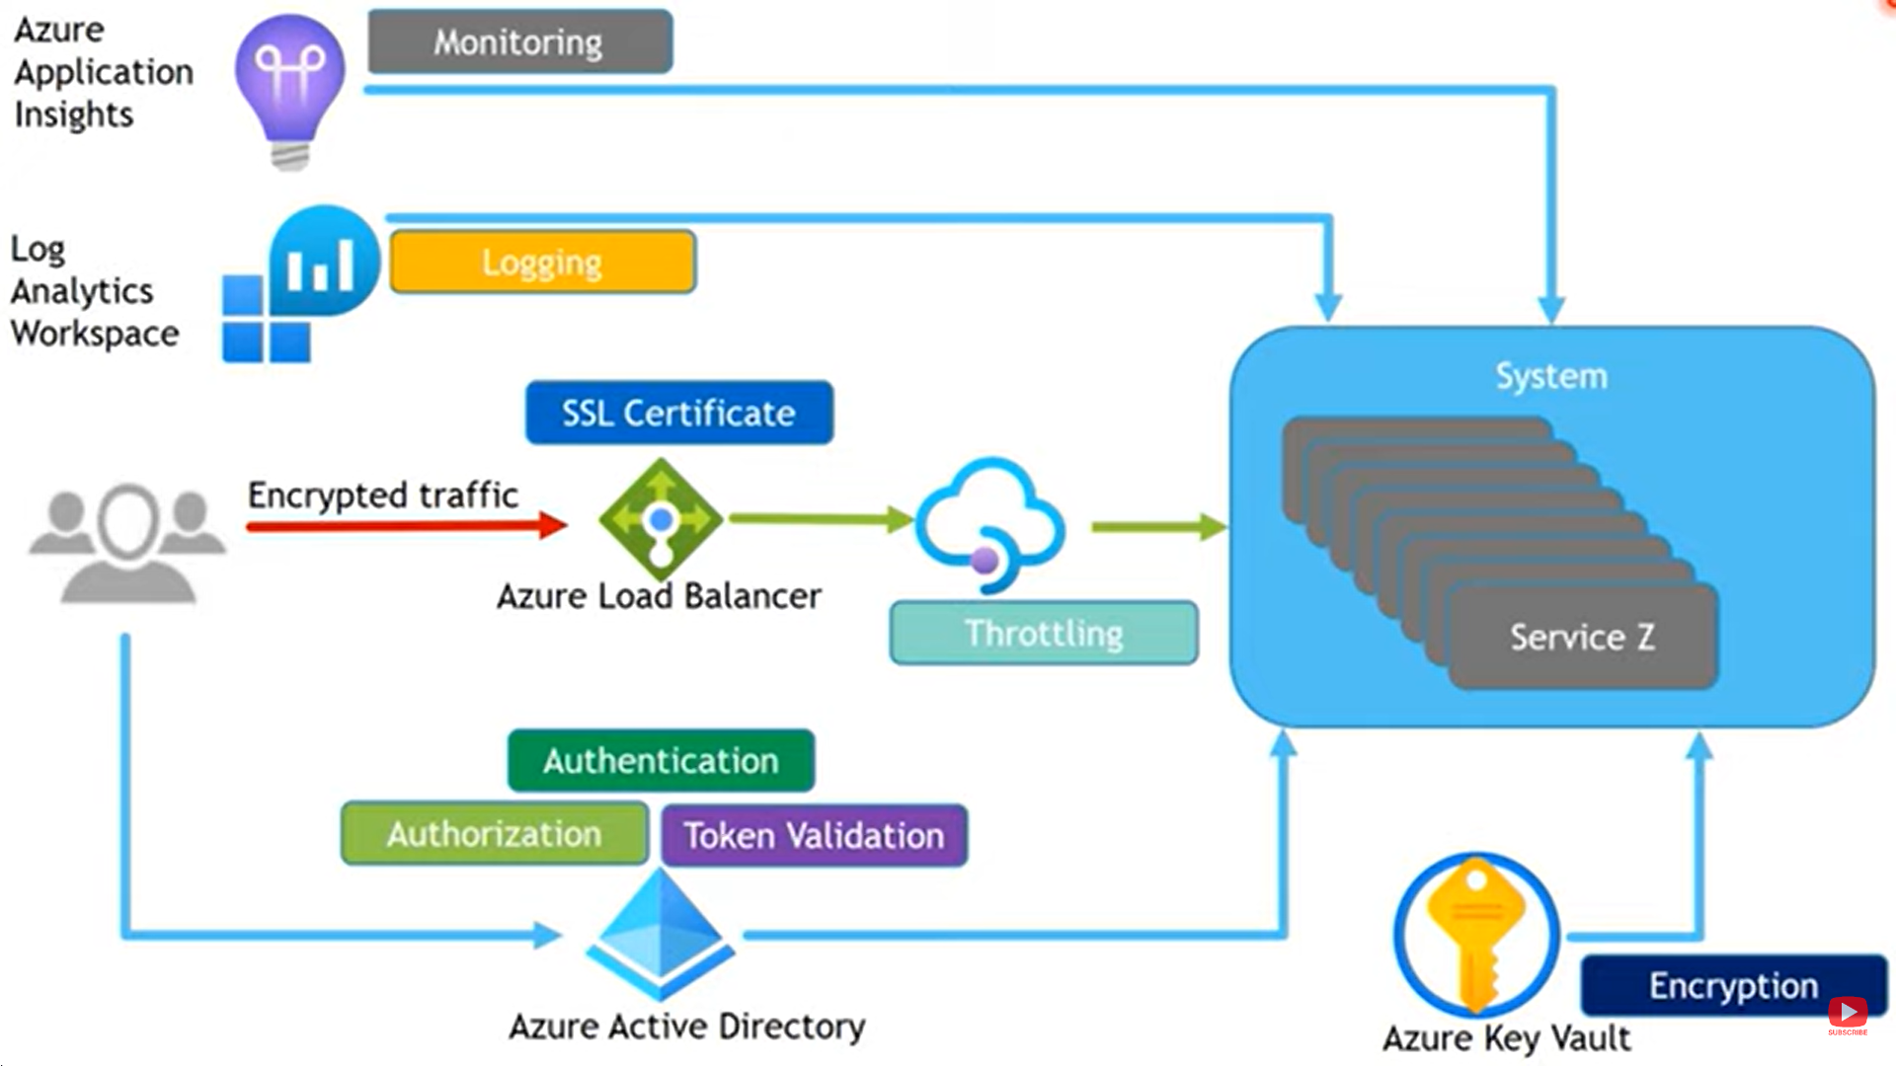
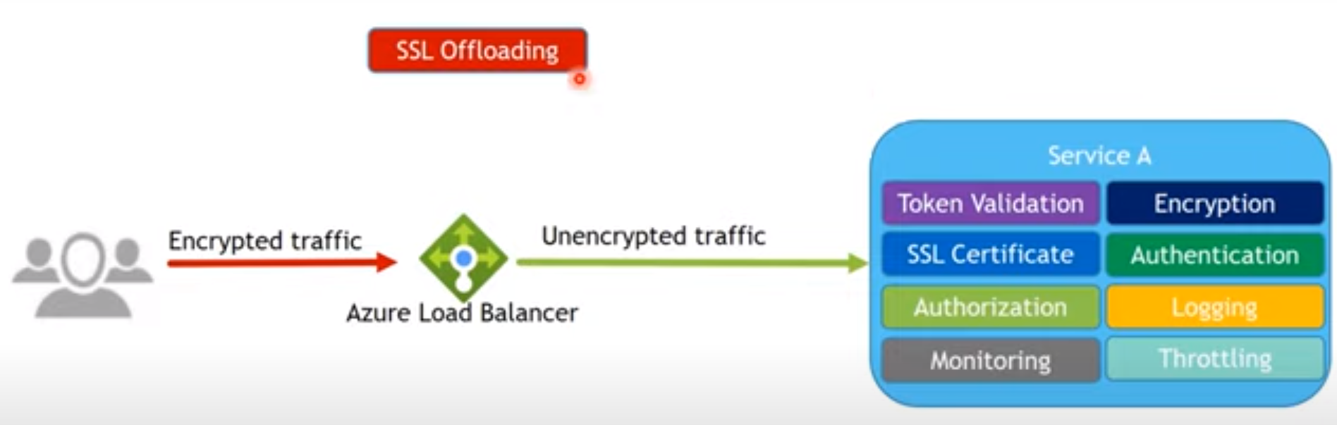

Slide 39
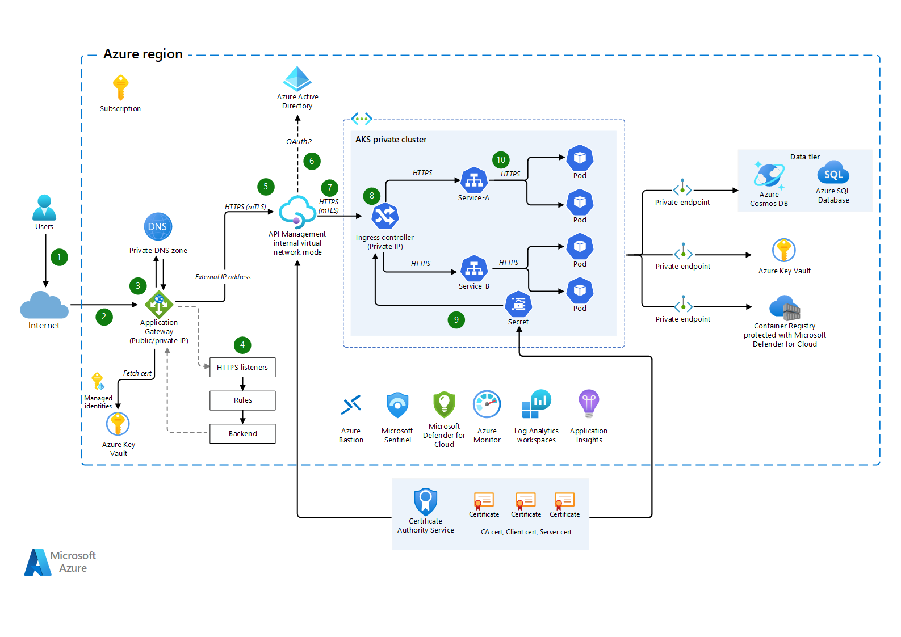
Azure API Management

Slide 40
Aspect | Best Practices | Tools/Techniques
Containerization | Use Docker for containerization to isolate microservices | Docker, Docker Compose, Kubernetes
Service Discovery | Implement service discovery for dynamic service location | Consul, Eureka, Kubernetes Services
Load Balancing | Use load balancers for distributing traffic | NGINX, HAProxy, Kubernetes Ingress Controllers
API Gateway | Implement an API gateway for routing and security | Ocelot, Kong, Ambassador, Azure API Management
Circuit Breaking | Implement circuit breaking for fault tolerance | Polly, Hystrix, Resilience4j
Distributed Tracing | Implement distributed tracing for monitoring and debugging | OpenTelemetry, Zipkin, Jaeger, Application Insights
Logging and Monitoring | Implement centralized logging and monitoring | ELK Stack (Elasticsearch, Logstash, Kibana), NewRelic, Prometheus, Grafana, Application Insights
Autoscaling | Implement autoscaling to handle varying workloads | Kubernetes Horizontal Pod Autoscaler (HPA), Azure Autoscale
Fault Tolerance | Design for resilience with graceful degradation | Circuit Breakers, Retry Strategies, Backoff Mechanisms
Database Scaling | Use sharding, replication, and partitioning for scalability | SQL Server Always On, MongoDB Sharding, Elasticsearch Replication
Authentication and Authorization | Implement secure authentication and authorization | IdentityServer, OAuth 2.0, JWT
Continuous Integration/Continuous Deployment (CI/CD) | Automate build, test, and deployment processes | Azure DevOps, Jenkins, GitHub Actions
Infrastructure as Code (IaC) | Use infrastructure provisioning tools for reproducibility | Terraform, Azure Resource Manager (ARM) Templates, AWS CloudFormation
Microservices Communication | Choose appropriate communication protocols and patterns | RESTful APIs, gRPC, Messaging Queues (RabbitMQ, Kafka)
Health Checks | Implement health checks for monitoring service health | ASP.NET Core Health Checks, Kubernetes Probes

Slide 41
9: Migration Strategy Details
Step 1: Assessment
Analyze the existing .NET framework application.
Identify components suitable for microservices.
Step 2: Planning
Define a migration roadmap.
Set timelines and milestones.
Step 3: Design
Design microservices architecture.
Select appropriate Azure services.
Step 4: Development
Refactor and build microservices using .NET Core.
Implement API Gateway and message broker.
Step 5: Testing
Conduct unit, integration, and performance testing.
Ensure data consistency and security.
Step 6: Deployment
Set up CI/CD pipelines with Azure DevOps.
Deploy microservices on Azure Kubernetes Service (AKS).
Step 7: Monitoring and Optimization
Use Azure Monitor and Application Insights for real-time monitoring.
Optimize performance and scale resources as needed.

Slide 42
10: Case Study 1: Enhanced Scalability
Client: Leading eCommerce platform.
Challenge: Inability to handle traffic spikes during promotions.
Solution: Migration to .NET Core microservices and deployment on AKS.
Outcome: Improved scalability, handling 300% increase in traffic seamlessly.

Slide 43
11: Case Study 2: Improved Performance
Client: Global online retailer.
Challenge: Slow website response times during high traffic periods.
Solution: Microservices architecture with Azure CDN and Cosmos DB.
Outcome: 40% reduction in page load times, enhancing user experience.

Slide 44
12: Why Choose Us?
Expertise in .NET Core and Azure.
Proven track record with successful eCommerce projects.
Comprehensive support throughout the migration and deployment process.
Commitment to delivering scalable and cost-effective solutions.

Slide 45
13: Q&A
Open floor for questions and discussions.
Contact information for follow-up queries.

Slide 46
14: Thank You
Closing remarks.
Thank you message.
Contact details (email, phone, website).

Slide 47
Use real-world examples and metrics to add credibility.
Address specific eCommerce pain points and how the proposed solution resolves them.
Highlight the financial and operational benefits of migrating to .NET Core microservices and deploying on Azure.

Slide 48
Design Pattern

Slide 49
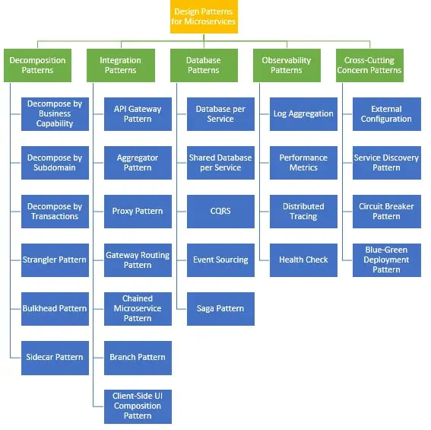
Design Pattern
Creational | Structural | Behavioral
Abstract Factory | Adapter | Mediator
Factory Method | Bridge | Memento
Singleton | Composite | Interpreter
Prototype | Decorator | Iterator
Builder | Facade | Chain of Responsibility
 | Flyweight | Command
 | Proxy | State
 |  | Strategy
 |  | Observer
 |  | Template
 |  | Visitor

Slide 50
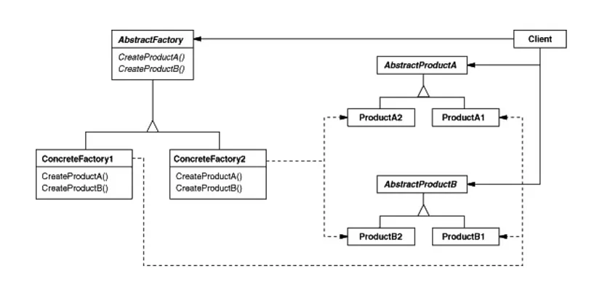
ProductA (TV) – (A1) Smart TV, (A2)Normal TV)
ProductB (Fridge) – (B1) Double door, (B2) Single Door

Slide 51
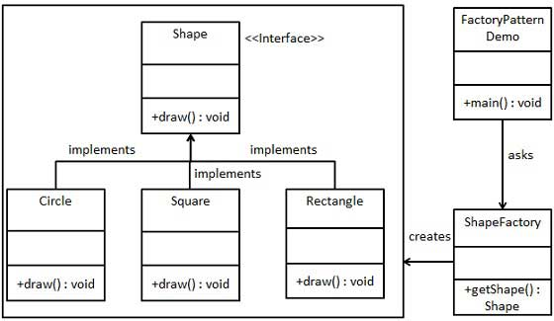

Slide 52
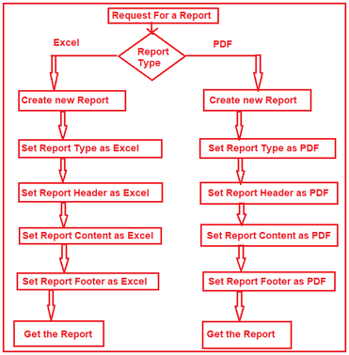

Slide 53
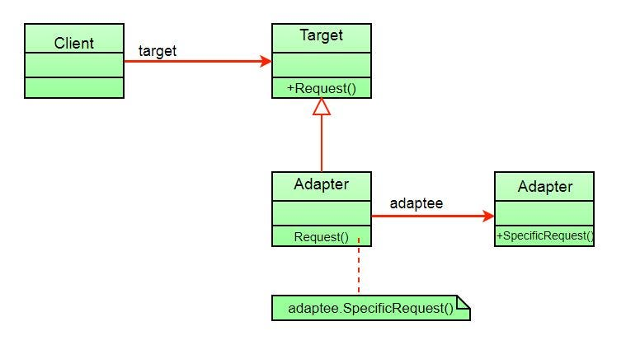
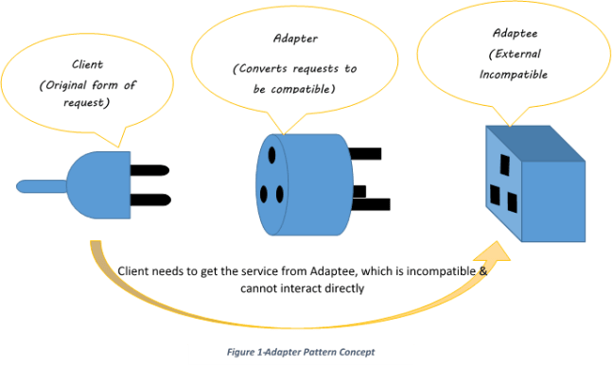
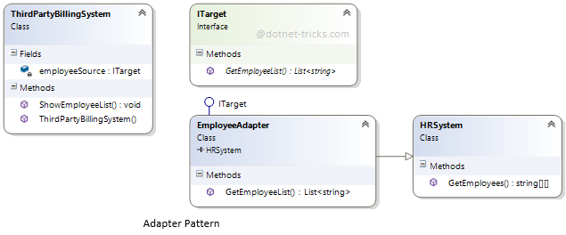

Slide 54
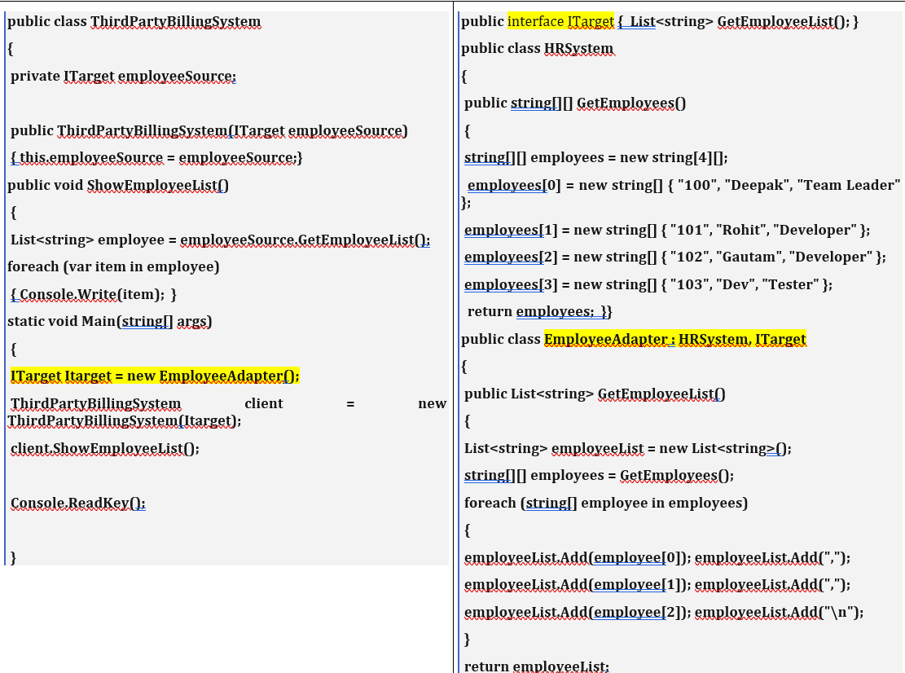

Slide 55
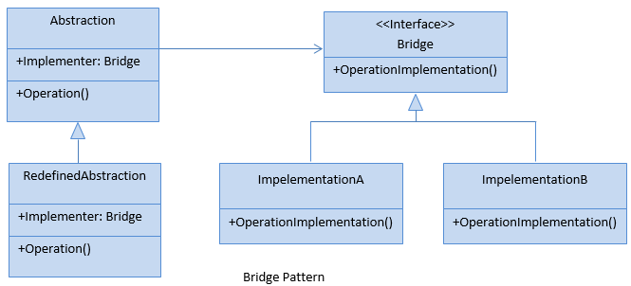
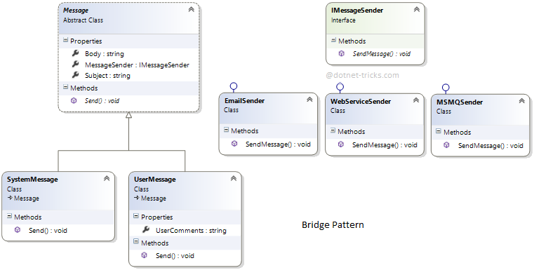

Slide 56
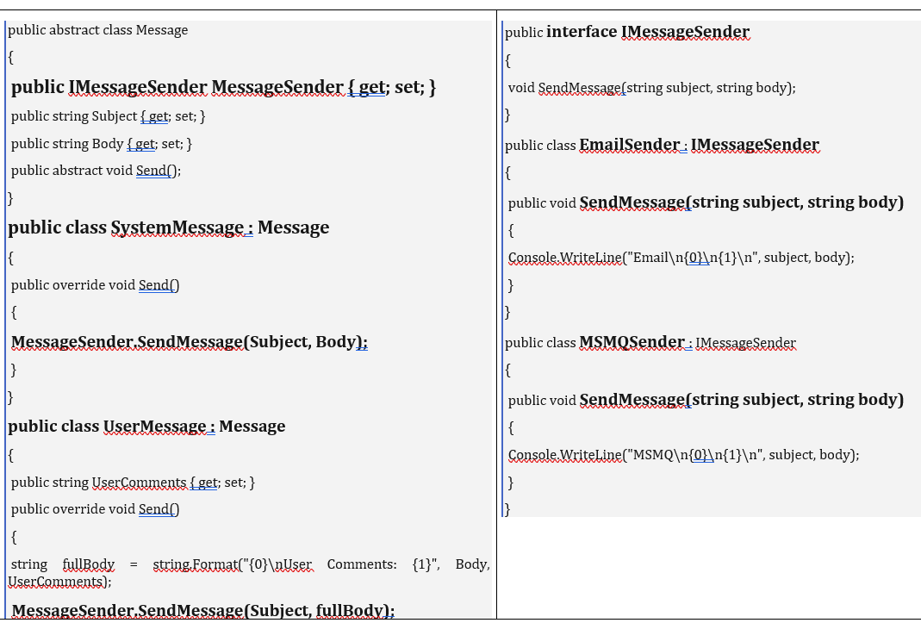

Slide 57
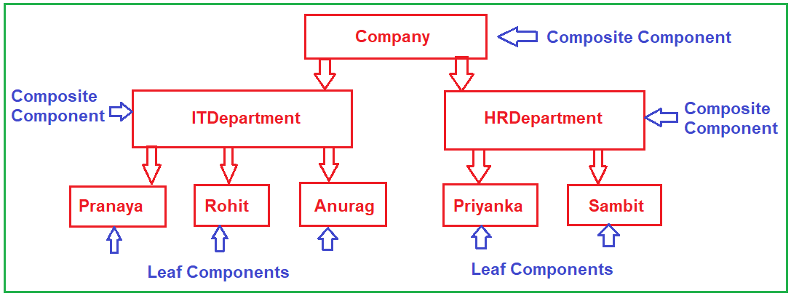

Slide 58
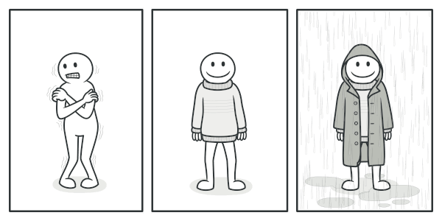
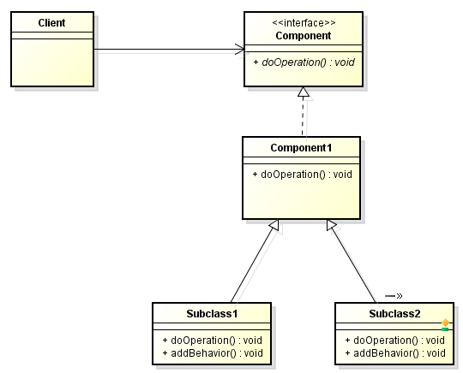
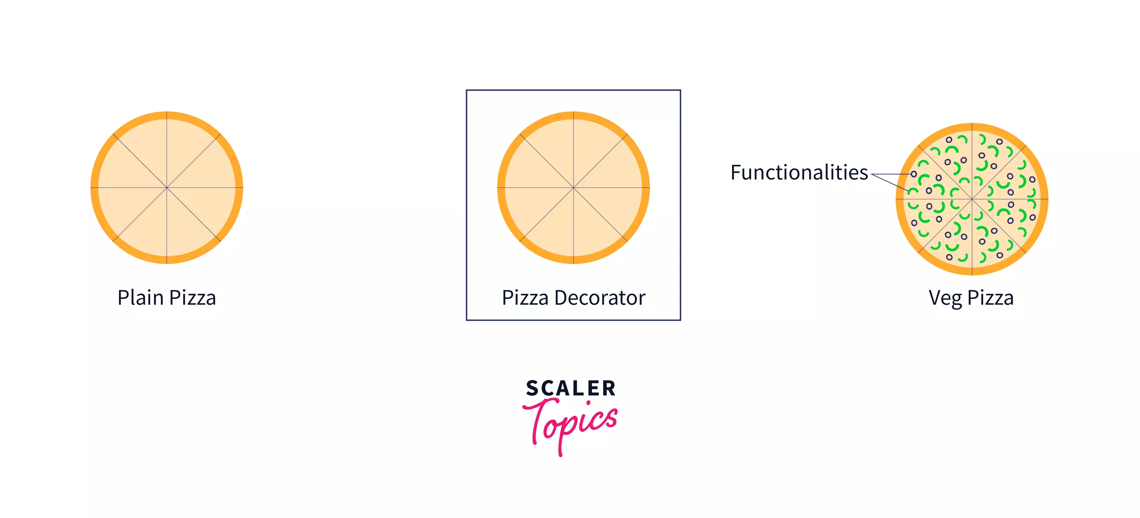
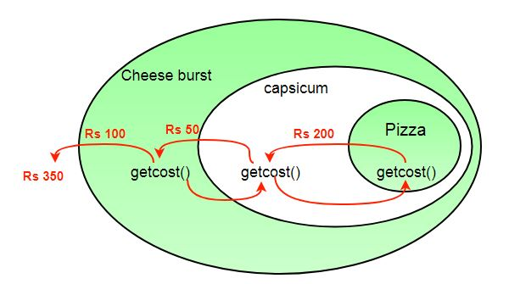

Slide 59
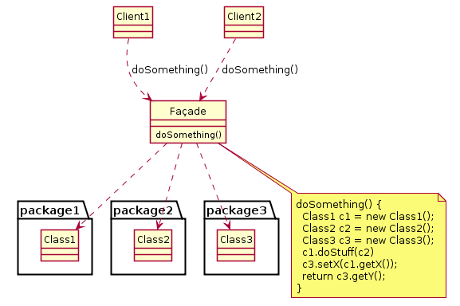

Slide 60
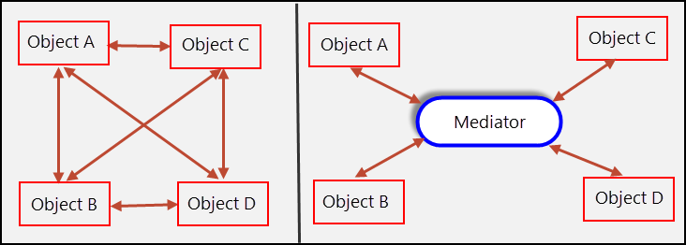
communication between objects is encapsulated within a mediator object

Slide 61
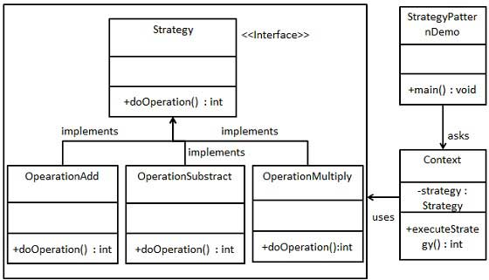

Slide 62
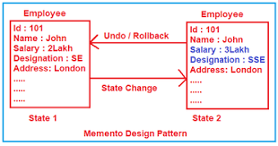
pattern is useful for scenarios where you need to perform an undo or rollback operation in your application.

Slide 63
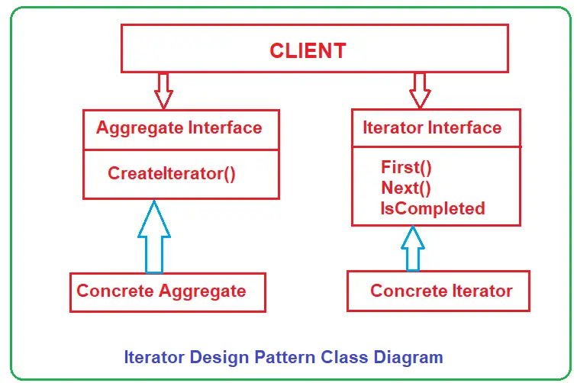

Slide 64



Slide 65



Slide 66


Slide 67


Slide 68




Event sourcing involves two steps:
(1) modeling the state changes made by an application as a set of immutable events, and
(2) modeling the state changes as responses to the events.

Slide 69


Slide 70



Slide 71



Slide 72
Project – We delivered

Slide 73


Slide 74


Slide 75


